Slide 1
MAXGBoost: A Fast Novel Heuristic Approach to Adaptive Learning Rates in Gradient Boosted Decision Trees
By: Anirudh Chintaluri, Radin Rezanezhad

Slide 2
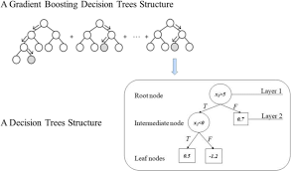
Fundamentals
GBDTs initialize with a decision tree that's evaluated using a loss function
The model minimizes loss by moving in the direction of the negative gradient
This process is similar to neural networks' backpropagation, but creates an ensemble decision tree model

Slide 3
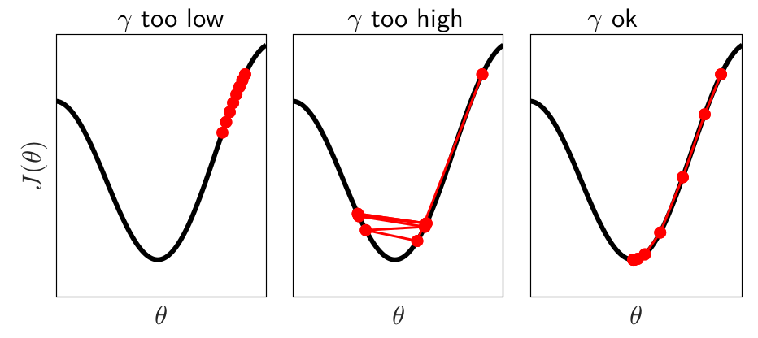
Learning Rate Mechanics
The algorithm adds new decision trees scaled by a learning rate (η)
Learning rate determines how far down the loss function the tree will go
Low η ensures convergence but requires more iterations and computational cost
High η speeds up convergence but risks overshooting the optimal solution

Slide 4
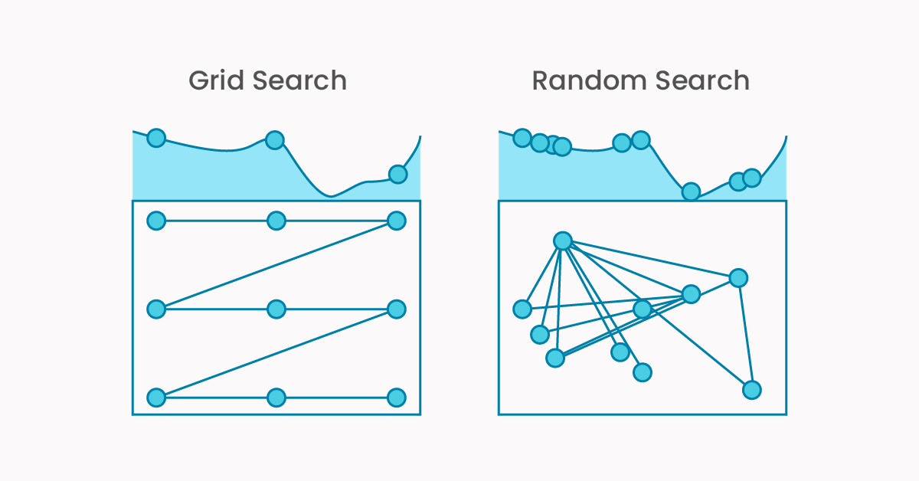
Learning Rate Optimization
Optimal learning rate depends on both dataset and loss function
Tuning requires iterative experimentation
Adaptive strategies help reduce need for extensive hyperparameter searches
Particularly important for datasets with high sparsity

Slide 5
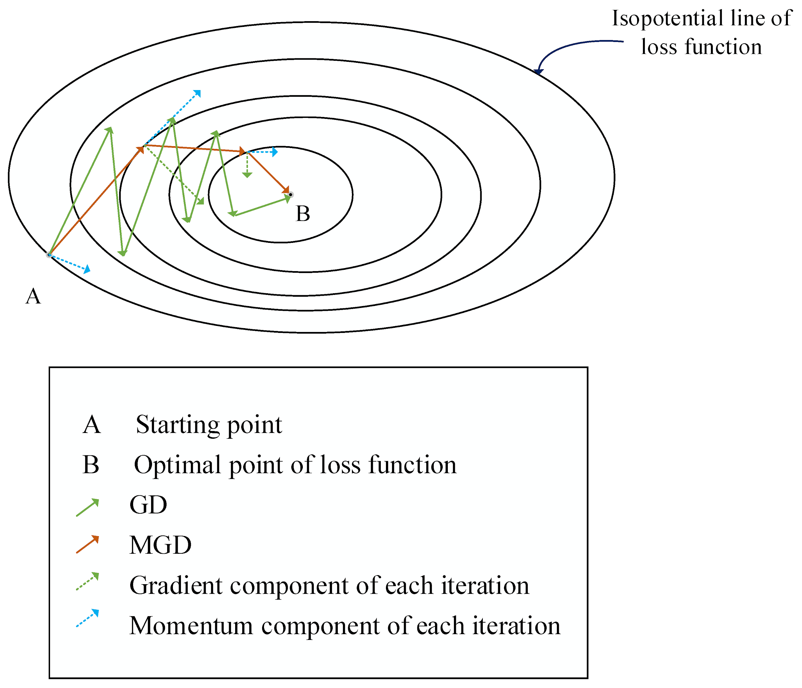
Introduction to MAXGBoost
Momentum Approximation XGBoost dynamically adjusts learning rate based on loss momentum
Enables faster convergence
Reduces need for manual optimization while maintaining high detection accuracy

Slide 6
The Dataset
Credit Card Fraud Detection
284,807 total instances
31 total attributes
Notable Features:
Time
Amount
V1-V38 -> Result of PCA
492 instances marked as fraud
< 0.2% of data
Dataset already preprocessed

Slide 7
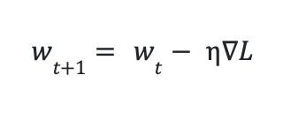
The Algorithm - Traditional Neural Network

Slide 8
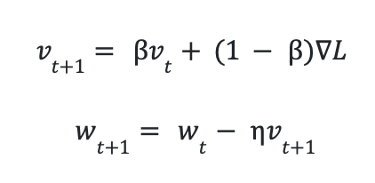
The Algorithm - Neural Network with Momentum
v = velocity
β = how influential past velocities are on the new velocity calculated
Converges faster than with a constant learning rate

Slide 9
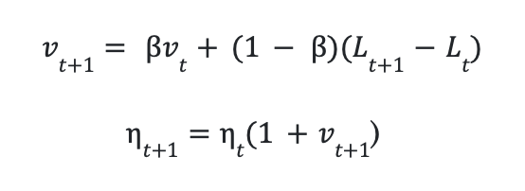
The Algorithm - MAXGBoost
Combines GBDT and momentum-based updates
Approximates ∇ L
Using momentum to update the learning rate
Loss increase = η increase
Loss decrease = η decrease

Slide 10
Experiments - Dataset
Splits
68%: Training
12%: Validation
20%: Testing
Analysis
5-fold Cross-validation
Results based on best fold per model

Slide 11
Experiments - Models
Decision Tree | Single Decision Tree
Random Forest | Ensemble Voting Decision Tree Model
Constant η XGBoost | XGBoost with a constant learning rate
Exponential Decay XGBoost | XGBoost with a learning rate multiplied by constant every iteration
MAXGBoost | XGBoost with Momentum Approximation

Slide 12
Experiments - Hyperparameters
Decision Tree | Max Depth = 4
Random Forest | Estimators = 5
Constant η XGBoost | Estimators = 423, η = 0.08
Exponential Decay XGBoost | Estimators = 423, x = 0.9
MAXGBoost | Estimators = 423, Initial η = 0.89, β = 0.99

Slide 13
Results
Model | Accuracy | Precision | Recall | AUC
Decision Tree | 0.99946 | 0.86813 | 0.80612 | 0.90296
Random Forest | 0.99951 | 0.77000 | 0.93902 | 0.96931
Constant η | 0.99977 | 0.88636 | 0.96296 | 0.98139
Exponential decay | 0.99979 | 0.88764 | 0.97531 | 0.98757
MAXGBoost | 0.99980 | 0.93827 | 0.92683 | 0.96337

Slide 14
Discussion - MAXGBoost Strengths
Best Precision in Fraud Detection
Exceptional performance in minimizing false positives
Effective for high-stakes financial environments
Reduces customer friction from false alerts
Minimizes operational costs from investigation overhead

Slide 15
Discussion - MAXGBoost Limitations
Relatively low AUC for Fraud Detection
Rapid learning rate decrease with small loss improvements
Limited exploration of feature space
Over-emphasis on strongly discriminative features
Underweighting of subtle fraud patterns

Slide 16
Conclusion
Decision Tree-based models effective in classifying positive class of fraud in < 0.2% of data
Increases the ability for law enforcement to correctly catch frauds
MAXGBoost best model comparing accuracy and precision
MAXGBoost most effective in preventing false accusations of fraud and increasing customer satisfaction
Exponential decay XGBoost most effective in catching fraudulent cases, compromising false accusations

Slide 17
Future Work
Hybrid Model Development
Combine strengths of EGB and MAXGBoost
Create integrated momentum-decay approach
Feature-specific momentum updates
Class-aware momentum adjustments

Slide 18
Thanks!
Questions?

Slide 19
References
Andrej Baranovskij. (2019, March 12). Selecting Optimal Parameters for XGBoost Model Training. Medium; Towards Data Science. https://medium.com/towards-data-science/selecting-optimal-parameters-for-xgboost-model-training-c7cd9ed5e45e
Beja-Battais, P. (2023, October 6). Overview of AdaBoost: Reconciling its views to better understand its dynamics. ArXiv.org. https://doi.org/10.48550/arXiv.2310.18323
Brownlee, J. (2016, September 15). Tune Learning Rate for Gradient Boosting with XGBoost in Python. Machine Learning Mastery. https://machinelearningmastery.com/tune-learning-rate-for-gradient-boosting-with-xgboost-in-python/
Chen, T., & Guestrin, C. (2016). XGBoost: a Scalable Tree Boosting System. Proceedings of the 22nd ACM SIGKDD International Conference on Knowledge Discovery and Data Mining - KDD ’16, 785–794. https://doi.org/10.1145/2939672.2939785
Credit Card Fraud Detection. (n.d.). Kaggle. https://www.kaggle.com/datasets/mlg-ulb/creditcardfraud/data
Ke, G., Meng, Q., Finley, T., Wang, T., Chen, W., Ma, W., Ye, Q., & Liu, T.-Y. (2017). LightGBM: A Highly Efficient Gradient Boosting Decision Tree. Neural Information Processing Systems; Curran Associates, Inc. https://papers.nips.cc/paper_files/paper/2017/hash/6449f44a102fde848669bdd9eb6b76fa-Abstract.html
Learning rate. (n.d.). Wikipedia. https://en.wikipedia.org/wiki/Learning_rate
Mohan, A. (2021, April 6). IEEE-CIS Fraud Detection - Top 5% Solution - Towards Data Science. Medium; Towards Data Science. https://medium.com/towards-data-science/ieee-cis-fraud-detection-top-5-solution-5488fc66e95f
Pedregosa, F., Varoquaux, G., Gramfort, A., Michel, V., Thirion, B., Grisel, O., Blondel, M., Müller, A., Nothman, J., Louppe, G., Prettenhofer, P., Weiss, R., Dubourg, V., Vanderplas, J., Passos, A., Cournapeau, D., Brucher, M., Perrot, M., & Duchesnay, É. (2018). Scikit-learn: Machine Learning in Python. ArXiv:1201.0490 [Cs]. https://arxiv.org/abs/1201.0490
Vitaly Bushaev. (2017, December 4). Stochastic Gradient Descent with momentum - Towards Data Science. Medium; Towards Data Science. https://medium.com/towards-data-science/stochastic-gradient-descent-with-momentum-a84097641a5d
Wang, C., Wang, Z., Ouyang, Y., & Soleimani, B. H. (2024, May 27). Adaptive Learning Rates for Gradient Boosting Machines. Proceedings of the Canadian Conference on Artificial Intelligence. https://caiac.pubpub.org/pub/py65wd3c/release/1

